Slide 1

FY 2021 Township Budget
Comprehensive Budget Presentation
Board of commissioners
October 6, 2020

Slide 2
Township Budget Overview FY 2021 Proposed Budgets
Fund | FY 2021 | FY 2020 | FY 2019 | FY 2018 | FY 2017 | FY 2016
General | $9,982,776 | $9,963,368 | $9,805,616 | $9,795,242 | $9,788,556 | $9,700,768
Golf | $1,645,682 | $1,617,041 | $1,562,587 | $1,315,433 | $1,437,633 | $1,405,537
Sewer | $3,716,264 | $3,740,229 | $3,702,426 | $3,531,482 | $3,248,305 | $4,386,654
Liquid Fuels | $383,300 | $420,251 | $428,884 | $422,990 | $401,826 | $382,129
Debt Service | - | - | - | $1,257,151 | $1,206,193 | $1,464,018
Emergency Services | $386,554 | $371,300 | $371,300 | $364,677 | $380,775 | $375,775

Slide 3
FY 2021 General Fund
West Norriton Township

Slide 4
Budget Development
Departments prepared baseline budgets.
Departments developed budget request for current services and for potential additional resources.
Budget proposals were reviewed and analyzed with staff.

Slide 5
Budget Revenues General Fund
Category | FY 2021 | FY 2020 | % Change
Real Estate Taxes | $4,178,427 | $4,165,175 | 0.32%
Act 511 Taxes | $3,901,000 | $3,901,000 | 0%
Business/Non-Business Licenses | $905,250 | $931,350 | -2.80%
Fines | $42,100 | $42,100 | 0%
Interest | $30,000 | $30,000 | 0%
Shared Revenues | $118,000 | $98,000 | 20.41%
Charges for Services | $5,000 | $5,000 | 0%
Public Safety & Highway | $347,496 | $258,346 | 34.51%
Recreation & Culture | $155,600 | $172,600 | -9.85%
Misc. Receipts | $396,073 | $360,170 | 9.97%
Intergov. Transfers | $0 | $50,000 | -100%
Totals | $10,078,946 | $10,013,741 | 0.65%

Slide 6

Budget Revenues General Fund

Slide 7
Revenue Sources General Fund
Real Estate Taxes and Act 511 Taxes account for approximately 80% of Township Revenues
 |  | 2018 | 2018 | 2019 | 2019 | 2020 | 2020 | 2021
G.L. # | Account Title | Budget | Actual | Budget | Actual | Budget | Actual | Budget
 | REVENUES |  | 12/31/2018 |  | 12/31/2019 |  | 9/30/2020
01.301.100 | Real Estate Taxes-Current | 3,177,901 | 3,136,285 | 3,182,723 | 3,155,459 | 3,199,090 | 3,010,685 | 3,209,500
01.301.101 | Real Estate Taxes-Debt-Current | 801,096 | 790,571 | 802,311 | 795,439 | 806,437 | 758,944 | 809,062
01.301.102 | Real Estate Taxes-Rec-Current | 66,206 | 65,336 | 66,307 | 65,739 | 66,648 | 62,723 | 66,865
01.301.200 | Real Estate Taxes-Prior Year | 25,000 | 0 | 25,000 | 30,451 | 25,000 | 49,710 | 25,000
01.301.400 | Delinquent Real Estate Tax | 60,000 | 60,618 | 60,000 | 57,174 | 60,000 | 43,599 | 60,000
01.301.600 | Real Estate Tax-Interim | 8,000 | 2,870 | 8,000 | 2,776 | 8,000 | 10,160 | 8,000
 | REAL PROPERTY TAXES | 4,138,204 | 4,055,680 | 4,144,341 | 4,107,038 | 4,165,175 | 3,935,820 | 4,178,427
01.310.010 | Per Capita Tax-Current | 3,000 | 737 | 3,000 | 1,165 | 3,000 | 1,164 | 3,000
01.310.020 | Per Capita Tax-Prior Year | 28,000 | 22,710 | 28,000 | 31,269 | 28,000 | 27,286 | 28,000
01.310.030 | Per Capita Tax-Delinquent | 10,000 | 17,517 | 10,000 | 12,890 | 10,000 | 15,563 | 10,000
01.310.100 | Deed Transfer Tax | 320,000 | 407,280 | 320,000 | 990,293 | 320,000 | 291,572 | 320,000
01.310.200 | Earned Income Tax | 3,100,000 | 3,319,363 | 3,100,000 | 3,385,314 | 3,200,000 | 2,537,071 | 3,200,000
01.310.510 | LST Tax | 340,000 | 351,086 | 340,000 | 351,856 | 340,000 | 258,361 | 340,000
 | ACT 511 ENABLING TAXES | 3,801,000 | 4,118,693 | 3,801,000 | 4,772,786 | 3,901,000 | 3,131,016 | 3,901,000

Slide 8
Budget Expenditures General Fund
Category | Proposed FY 2021 | FY 2020 | Variance
Administration (Portion) | $763,889 | $747,596 | $16,293
Police | $4,122,230 | $3,941,231 | $180,999
Building/Zoning | $143,261 | $142,074 | $1,817
Health & Welfare | $7,700 | $7,700 | -
Public Works (Portion) | $456,957 | $460,730 | -$3,773
Recreation | $542,379 | $540,940 | $1,439
Benefits & Insurance (Portion) | $3,751,360 | $3,938,097 | -$186,737
Intergov. Transfer | $195,000 | $185,000 | $10,000
Total | $9,982,776 | $9,963,368 | $19,408 (0.19%)

Slide 9
Budget Expenditures General Fund

Slide 10
Budget Revenues vs. Expenditures General Fund
Revenues
Expenditures

Slide 11
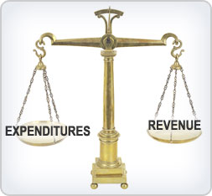

Budget Revenues vs. Expenditures General Fund
Revenues
$10,078,946
Expenditures
$9,982,776
Balanced Budget for FY 2021 Projected surplus of $96,170

Slide 12

Impacts to FY 2021 Budget
Energy Savings for the General, Golf and Sewer Funds
New 60 month term with Hudson Energy for 100% Green Electricity
100% Green-e Energy Certified Renewables in Wind
Proposed savings of $14,988 per year ($74,941 savings over term)
Term (months) | Rate ($.kWh) | Supplier | Est. Annual Cost | Annual Impact ($) | Annual Impact (%) | Term Impact ($)
60 | $0.05050 | Hudson Energy | $43,752 | $14,988 | 26% | $74,941

Slide 13

Impacts to FY 2021 Budget
Pension obligations for Uniformed & Non-Uniformed Plans
Estimated State Aid for FY 2021 is $343,073
2019 Unit Value = $5,120.4991 67 units (23 Police & 21 Non-Uniform)
MMO | 2021 | 2020 | 2019 | 2018
Non-Uniform | $1,061,965 | $1,032,570 | $1,058,363 | $1,051,544
Uniform | $493,157 | $498,641 | $465,570 | $469,889

Slide 14

Impacts to FY 2021 Budget
Healthcare Renewal
As of October 2020, the renewal for healthcare will increase 2.43%
Group | FY 2021 Cost
AFSCME/Management | $668,885
Police | $851,445
Police Retirees | $232,164
Fund | Allocated Portion
General | $1,513,325
Sewer | $130,540
Golf | $108,630

Slide 15
Impacts to FY 2021 Budget Wage Analysis (General Fund)
 | 2021 Budget | 2020 Budget | 2019 Budget | 2018 Budget
AFSCME | 16 | 16 | 16 | 16
Police | 27 | 27 | 27 | 27
Management | 8 | 8 | 8 | 8
 | FY 2021 | FY 2020 | Difference
AFSCME | $587,270 | $583,076 | $4,194
Police *w/Chief & Deputy Chief | $3,069,281 | $2,957,340 | $111,941
Management | $424,685 | $410,332 | $14,353
Police Contract: 3.25% Raise
AFSCME Contract: 3.0% Raise

Slide 16
Impacts to FY 2021 Budget Debt Service
2014 Street Light Upgrade Borrowing (Continental Bank)
$105,232.25 (yearly)
2020 Capital Borrowing (Webster Bank)
$170,462.40 (yearly)
Total Debt Service to General Fund: $275,694.65

Slide 17
2021 Township Tax Structure
Real Estate Taxes | Millage Rate
General Purpose | 3.360
Debt Service | 0.847
Fire Equipment & Firehouses | 0.198
Recreation | 0.070
Total Real Estate Tax Rate | 4.475
Tax | Rate
Realty Transfer Tax | 0.50%
Earned Income Tax | 0.50%
Per Capita Tax | $5.00
Local Services Tax | $52.00
Mechanical Devices Tax | $225.00

Slide 18
Property Tax Assessment
Year | Total Certified Assessed Value | Percent Change From Prior Year
2011 | $972,987,387
2012 | $971,739,027 | -0.13%
2013 | $971,569,521 | -0.02%
2014 | $971,061,251 | -0.05%
2015 | $973,351,701 | 0.24%
2016 | $974,934,951 | 0.16%
2017 | $974,574,922 | -0.04%
2018 | $974,882,102 | 0.03%
2019 | $980,598,291 | 0.59%
2020 | $985,509,351 | 0.50%
2021 (est) | $984,750,970 | -0.07%
Change 2011-2021 | $11,763,583
Percent Change 2011-2021 | 1.2%
Land Use | Assessed Value | Percent of Total Assessed Value
Residential | $708,035,947 | 71.9%
Commercial | $214,675,711 | 21.8%
Industrial | $57,115,556 | 5.8%
Lot | $2,954,252 | 0.3%
Agriculture | $1,969,501 | 0.2%
Total | $984,750,970
13% of the Township’s
real estate is tax exempt.

Slide 19
FY 2021 Total Tax Bill *Assumes no tax increase from County*

Slide 20
Municipality | 2020 Montgomery County Millage Rate | 2020 Montgomery County Community College Millage Rate | 2020 Municipal Millage Rate | 2018/2019 School District Millage Rate | Total Millage Rate | Rank in County by Total Millage Rate
Cheltenham | 3.459 | 0.39 | 9.5695 | 47.0539 | 60.4724 | 1
Pottstown | 3.459 | 0.39 | 13.161 | 41.9667 | 58.9767 | 2
Norristown | 3.459 | 0.39 | 15 | 39.204 | 58.053 | 3
Jenkintown | 3.459 | 0.39 | 8.553 | 42.2143 | 54.6163 | 4
West Norriton | 3.459 | 0.39 | 4.475 | 39.204 | 47.528 | 5
Upper Pottsgrove | 3.459 | 0.39 | 4 | 38.102 | 45.951 | 6
Lower Pottsgrove | 3.459 | 0.39 | 3.868 | 38.102 | 45.819 | 7
East Norriton | 3.459 | 0.39 | 2.727 | 39.204 | 45.78 | 8
Lower Moreland | 3.459 | 0.39 | 4.94 | 36.7205 | 45.5095 | 9
Abington | 3.459 | 0.39 | 4.851 | 36.621 | 45.321 | 10
Upper Dublin | 3.459 | 0.39 | 5.992 | 35.2634 | 45.1044 | 11
West Pottsgrove | 3.459 | 0.39 | 3 | 38.102 | 44.951 | 12
Schwenksville | 3.459 | 0.39 | 6.4 | 34.51 | 44.759 | 13
Narberth | 3.459 | 0.39 | 9.865 | 30.1734 | 43.8874 | 14
Hatboro Borough | 3.459 | 0.39 | 9.789 | 30.024 | 43.662 | 15
Collegeville | 3.459 | 0.39 | 5.2 | 34.51 | 43.559 | 16
Rockledge | 3.459 | 0.39 | 7.35 | 31.77 | 42.969 | 17
Springfield | 3.459 | 0.39 | 4.441 | 34.4687 | 42.7587 | 18
Royersford | 3.459 | 0.39 | 10.2 | 28.1921 | 42.2411 | 19
Lower Frederick | 3.459 | 0.39 | 2.82 | 34.51 | 41.179 | 20
Upper Moreland | 3.459 | 0.39 | 5.469 | 31.7559 | 41.0739 | 21
Telford | 3.459 | 0.39 | 6.74 | 30.32 | 40.909 | 22
Souderton | 3.459 | 0.39 | 5.78 | 30.32 | 39.949 | 23
Perkiomen | 3.459 | 0.39 | 0.62 | 34.51 | 38.979 | 24
Trappe | 3.459 | 0.39 | 0.47 | 34.51 | 38.829 | 25
West Norriton Township’s 2020 total millage rate ranks 5th highest out of 62 municipalities in Montgomery County.
West Norriton Township’s 2020 township millage rate ranks 26th out of 62 municipalities in Montgomery County.

Slide 21

Real Estate Tax Bill
Tax Bill
Average home assessment in West Norriton Township is $125,000
$125,000 x 4.475 mils = $559.38
General - $419.53
Debt - $106.28
Fire – $24.62
Parks - $8.95

Slide 22

Department Highlights Administration
Personnel
Township Commissioners
Tax Collector
Township Manager/Secretary
Director of Administration
Director of Finance
Bookkeeper
Secretary-Code Enforcement
Receptionist
Budget Impacts
Salary costs
Increased advertising costs & printing
Legal and Engineering fees
Computers and Technology costs

Slide 23

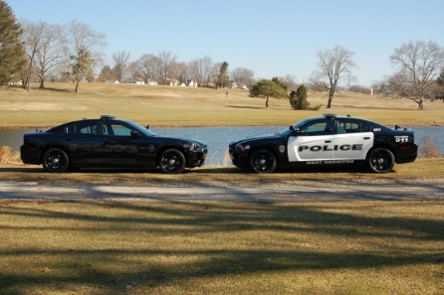
Department Highlights Police
Personnel
Chief of Police
Deputy Chief of Police
(5) Sergeants
(3) Detectives
(4) Corporals
(13) Patrol
Lead Clerk
Secretary
Receptionist
Budget Impacts
Salary & Contractual items
Maintains existing level and services of the police force

Slide 24

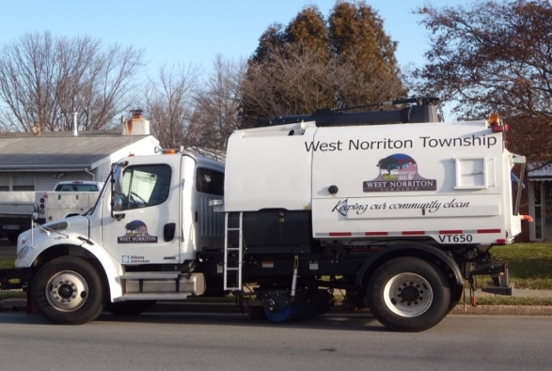
Department Highlights Building & Zoning Health & Welfare
Personnel
Director of Public Works & Planning
Budget Impacts
Salary (portion)
Code review/inspection costs
Costs associated with disposal of asphalt and street sweeper

Slide 25
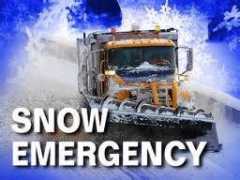

Departmental Highlights Public Works
Personnel
Director of Public Works & Planning
Foreman
Assistant Foreman
(4) Laborers
Mechanic
(3) Seasonal
Budget Impacts
Maintains all departmental services at current levels
Department Facts
38.14 miles of roadway
898 street lights
2,054 street signs
15 signalized intersections

Slide 26



Departmental Highlights Parks & Recreation
Personnel
Director of Parks & Recreation
Assistant Director
Various seasonal employees
Budget Impacts
Maintains current programs and services
Capital Improvements
New pavilion at Centennial Park
Tree Removal
New message boards and park signage

Slide 27
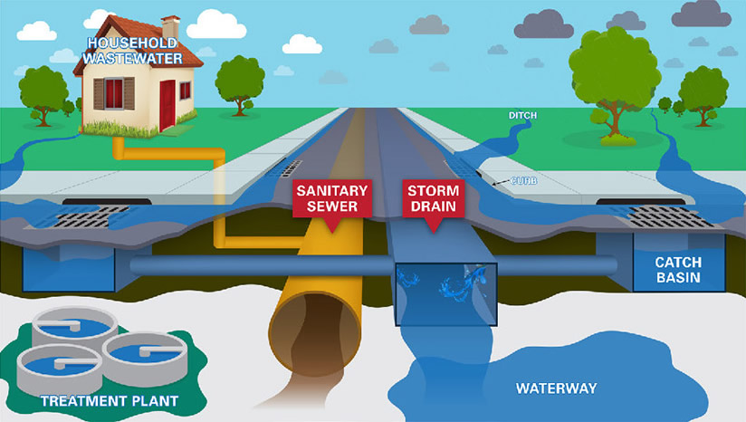
FY 2021 Sewer Fund
West Norriton Township

Slide 28
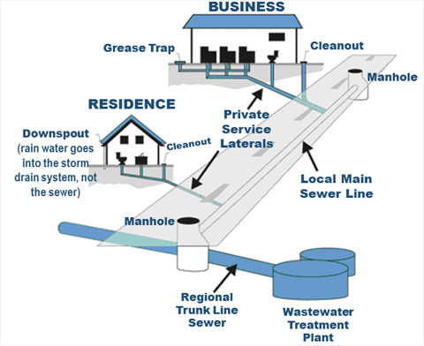
FY 2021 Sewer Fund
Sewer Fund revenues reflect rate increase that went into effect on January 1, 2015
No proposed rate increase for FY 2021

Slide 29
FY 2021 Sewer Fund Revenues
 |  | 2018 | 2018 | 2019 | 2019 | 2020 | 2020 | 2021
G.L. # | Account Title | Budget | Actual | Budget | Actual | Budget | Actual | Budget
 | REVENUES |  | 12/31/2018 |  | 12/31/2019 |  | 9/30/2020
80.341.000 | Interest | 2,500 | 4,585 | 2,500 | 25,458 | 7,500 | 7,205 | 7,500
80.354.015 | LSA Grant-Sewer Rehab
80.364.100 | Sewer Rental | 3,482,189 | 2,581,686 | 3,480,000 | 3,478,164 | 3,480,000 | 2,510,876 | 3,480,000
80.364.101 | Penalties on Sewer Rental | 72,000 | 55,576 | 72,000 | 84,796 | 72,000 | -17,859 | 72,000
80.364.102 | Sewer Certifications | 8,000 | 9,390 | 8,000 | 10,775 | 8,000 | 8,525 | 8,000
80.364.105 | Application Fees | 500 | 100 | 500 | 300 | 500 | 100 | 500
80.364.110 | Sewer Tapping Fees |  | 2,740 |  | 136,956 |  | 2,740
80.364.313 | Reimbursement Engineer-Devel. | 2,500 | 500 | 2,500 | 1,500 | 2,500 | 500 | 2,500
80.380.000 | Miscellaneous Receipts |  | 100 |  | 1,550,175 |  | 150
80.380.002 | Refund - Insurance
80.391.000 | Proceeds of Gen. Fixed Assets
80.392.010 | Transfer from General Fund |  | 140,967
80.392.080 | Transfer from Sewer Capital
80.392.100 | Transfer from Capital Reserve
80.392.150 | Transfer from GF - PLGIT |  |  |  | 103
80.392.200 | Transfer from Sinking Fund |  | 274,851
80.393.000 | Revenues Bonds/Notes/Loans | 300,000 | 0 | 450,000 |  | 450,000 |  | 450,000
 | TOTAL REVENUE | 3,867,689 | 3,070,494 | 4,015,500 | 5,288,227 | 4,020,500 | 2,512,236 | 4,020,500

Slide 30
FY 2020 Sewer Fund Revenues
Sewer Fees make up 87% of revenues in Sewer Fund

Slide 31
FY 2021 Sewer Fund Expenditures
Administration (GL 400-401)
Audit (GL 402)
Technology (GL 407)
General Government Building (GL 409)
Public Works (GL 430-438)
Benefits & Insurances (GL 483-486)

Slide 32
FY 2021 Sewer Fund Expenditures
 | FY 2021 | FY 2020 | FY 2019
Administration (400-401) | $183,679 | $177,670 | $173,819
Audit (402) | $10,000 | $7,500 | $7,500
Legal (404) | $30,000 | $36,600 | $36,600
Technology (407) | $38,700 | $38,500 | $35,952
Gen. Government Building (409) | $34,810 | $30,810 | $30,810
Sewer (429) | $2,185,627 | $2,170,589 | $2,165,839
Public Works (430-438) | $268,178 | $266,026 | $256,728
Benefits & Insurance (483-486) | $293,506 | $360,308 | $333,325
Debt Service (471-472) | $633,465 | $617,025 | $623,553
Transfer to Debt (492) | $35,000 | $35,000 | $35,000
Transfer to General (492) | $0 | $0 | $0
TOTAL | $3,716,264 (-0.02%) | $3,740,229 | $3,707,826

Slide 33
Sewer Rate Structure
Base Rate by
Category 1: $42.00 (Single Family)
Category 2: $107.00 (Flat Rate)
Category 3: $82.00 (2/3 Units)
Category 4: $42.00 (4+ Units)
Category 5: $87.00 (Commercial)
Consumption Rate
$7.51 per 1,000 gallons (over 3,000 gallon credit)
Consumption Credit
3,000 gallons

Slide 34
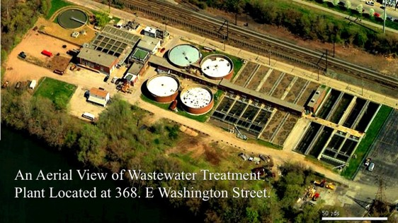
Largest Cost of Sewer Fund Sewer Treatment Cost FY 2021 $950,000

Slide 35
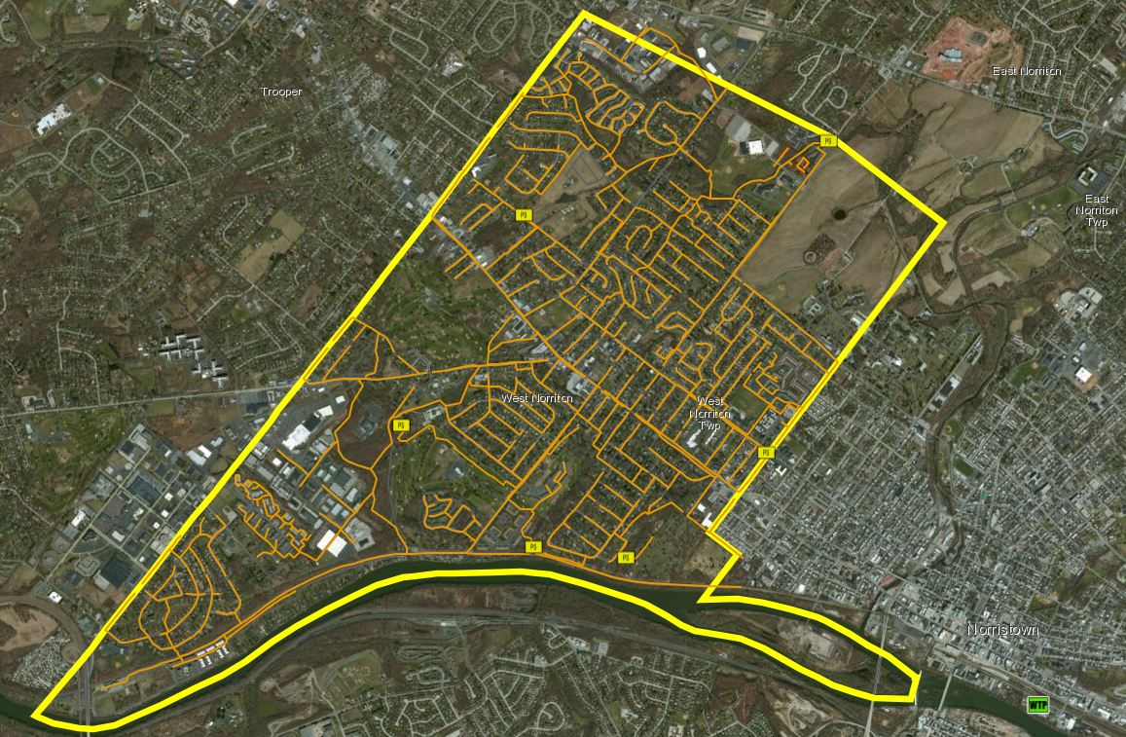

Slide 36
Budget Revenues vs Expenditures Sewer Fund
Revenues
$4,020,500
(Includes $450,000 of bond proceeds for capital)
Expenditures
$3,716,267
$304,236 Projected Surplus for FY 2021

Slide 37

FY 2021 Golf Fund
West Norriton Township

Slide 38
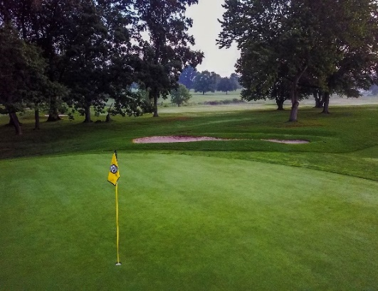
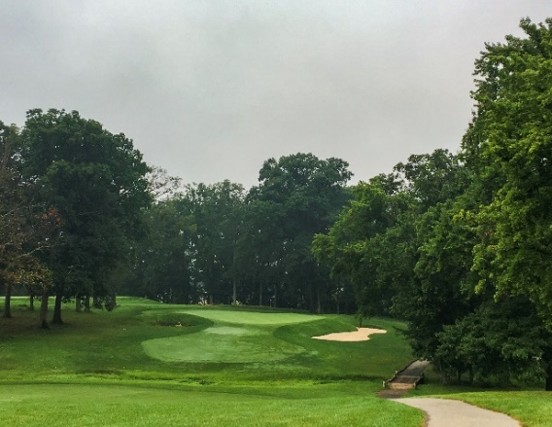

Budget Revenues Golf Fund
Revenues for the FY 2021 Budget have been projected based several recommended changes:
Elimination of Annual Pass program from non-Township residents.

Slide 39
Budget Revenues Golf Fund
 |  | 2018 | 2018 | 2019 | 2019 | 2020 | 2020 | 2021
G.L. # | Account Title | Budget | Actual | Budget | Actual | Budget | Actual | Budget
 | REVENUES |  | 12/31/2018 |  | 12/31/2019 |  | 9/30/2020
20.341.000 | Interest Earnings | 500 | 2,640 |  | 26,224 | 9,858 | 6,101 | 9,858
20.367.100 | Greens Fees | 887,000 | 881,100 | 893,000 | 1,019,270 | 905,000 | 957,903 | 1,205,000
20.367.101 | Membership | 96,000 | 136,144 | 90,000 | 67,550 | 120,000 | 62,450 | 16,000
20.367.105 | Power Carts | 215,000 | 205,860 | 218,000 | 254,988 | 220,000 | 84,583 | 95,000
20.367.110 | Gift Certificates (Pro Shop) |  | 3,467 | 0 | 2,628 | 0 | -2,236
20.367.115 | Outing Deposit |  | 0 | 0 | 25 | 0
20.367.144 | Handicaps | 2,480 | 0 | 2,480 | 506 | 3,000 |  | 4,000
20.367.300 | Tee-Advertising | 1,800 |  | 1,800 |  | 1,800
20.367.510 | Rent-Grove |  |  | 0 |  | 0
20.367.515 | Lease-Trinity Broadcasting | 46,800 | 4,675 | 0 | 102,850 | 0
20.367.520 | Lease Restaurant | 27,600 | 26,400 | 27,600 | 29,526 | 27,600 | 21,006 | 0
20.367.800 | Hand Carts | 1,800 | 1,897 | 1,800 | 2,200 | 2,000 | 1,260 | 1,850
20.367.900 | Pro Shop Revenue |  |  | 0 |  | 0 | 9,661
20.367.950 | Sales Tax | 13,008 | 12,471 | 13,188 | 15,401 | 13,320 | 5,522 | 5,811
20.380.000 | Miscellaneous Receipts |  |  | 0 | 1,644 | 0 | 57
20.391.000 | Proceed on Sale of Fixed Asset |  |  | 0 |  | 0 | 1,300
20.392.010 | Transfer from General Fund |  |  | 0 |  | 0
20.392.020 | Transfer from Capital Fund |  |  | 314,719 | 0 | 314,463 |  | 308,163
20.392.600 | Transfer from Escrow Fund | 23,445 | 121,360 | 0 | 0 | 0
 | TOTAL REVENUE | 1,315,433 | 1,396,015 | 1,562,587 | 1,522,811 | 1,617,041 | 1,147,607 | 1,645,682

Slide 40
Annual Pass Program Recommended Elimination
Annual Pass holders are responsible for 19%-26% of our rounds while only generating 7%-8% of our yearly total revenue.
The “break-even” point is between 45-65 rounds of golf and the average Annual Pass holder plays approximately 130 rounds of golf.
The average cost per round for Annual Pass holders is approximately $12-$14 per round while non-pass holder average cost per round is approximately $37-$40 per round.
Recommendation
Offer Annual Pass program for Township residents only. Currently, there are 11 residents out of the 75 total Annual Passes

Slide 41
Budget Expenditures Golf Fund
 | FY 2021 | FY 2020 | FY 2019
Participant Recreation (452) | $1,120,452 | $1,105,057 | $1,040,730
Participant Recreation (453) | $65,811 | $37,394 | $37,394
Benefits & Insurance (486) | $144,040 | $160,127 | $155,856
Debt Service (471-472) | $171,000 | $314,463 | $314,719
Transfer to Debt(492) | ~ | ~ | ~
Transfer to Capital Reserve (492) | ~ | ~ | ~

Slide 42
Budget Expenditures Highlights Golf Fund
Wages
Maintenance: $189,642
Pro Shop: $135,000
Salaried Staff: $164,234
Part-time Employees: $158,000
Agriculture & Chemicals: $140,000
Parts: $68,000
Healthcare: $130,540
Debt Service: $171,000
Capital Improvements
Bunker completed on Hole 15
Tree removal on Hole 5
Cart path improvements

Slide 43
Budget Revenues vs Expenditures Golf Fund
Revenues
$1,645,682
Expenditures
$1,645,682

Slide 44
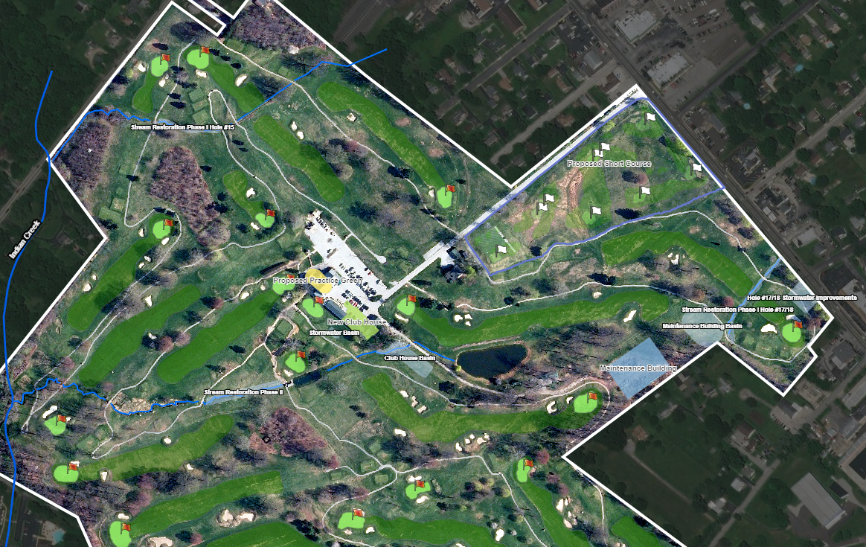
Capital Planning

Slide 45
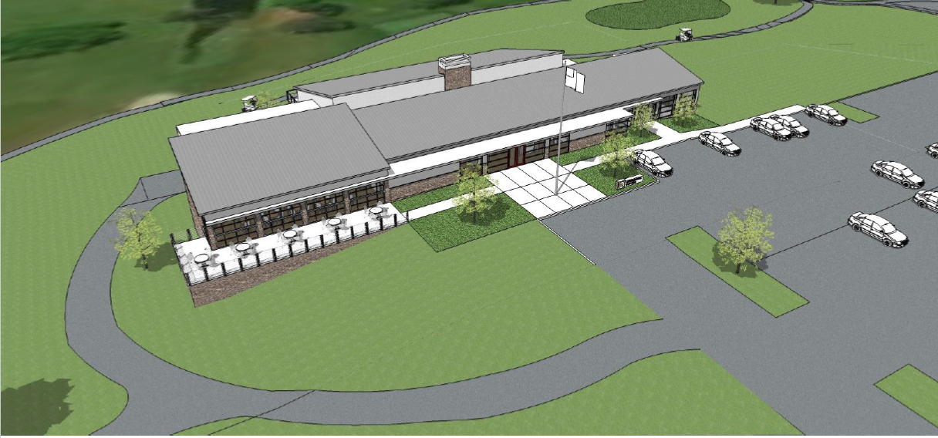
Proposed New Banquet/Pro Shop Facility
No new debt service as part of FY 2021 Budget
Currently pursuing a RCAP grant

Slide 46

FY 2021 Liquid Fuels Fund
West Norriton Township

Slide 47
Liquid Fuels Fund
Revenues for fund are based on the state allocation of gas tax receipts
Money must be kept from General Fund and interest be kept separate
Expenses are based on the allowable items through the Liquid Fuels program

Slide 48
Liquid Fuels
Revenues
Expenses
State Allocation | $386,554
Interest | $1,000
Total | $386,554
Traffic Lights | $20,000
Street Signs | $7,000
Street Lights | $90,000
Road Salt | $35,000
Road Materials | $10,000
Storm Sewers & Drains | $20,000
Road Resurfacing | $173,137
Debt Service | $31,418
Total | $386,554
FY 2021 budget includes debt service for a 2017 Cat 420F2IT Backhoe
Purchase as part of the CO-STARS Program

Slide 49
FY 2021 Emergency Services Fund
West Norriton Township

Slide 50
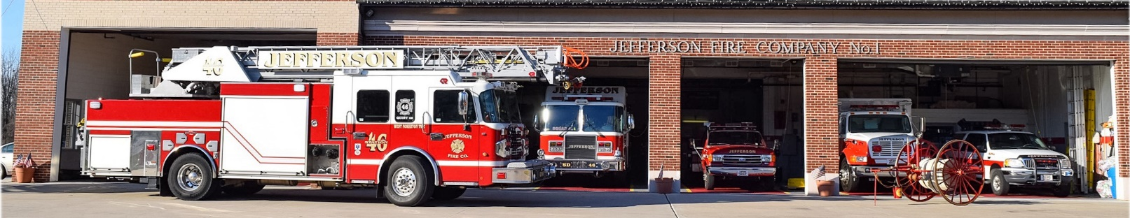
Emergency Services Fund
Includes expenses for:
Allocation to Jefferson Fire Company
Fireman’s Relief Grant to Jefferson Fire Company
Fees associated with fire hydrants in Township
Wages and expenses for Fire Marshal & Deputy Fire Marshal
Volunteer Fire Service Credit Program
Revenues for fund:
Fireman’s Relief Grant
Transfer from General Fund
Includes Fire Tax Millage

Slide 51

Emergency Services Fund
Revenues
Expenses
Revenue
Real Estate Tax | $189,554
Fireman’s Relief | $106,597
Transfer from General Fund | $94,869
Total | $390,597
Expense
Salaries & Wages | $10,600
Expense-Fire Marshal | $5,000
Volunteer Fire Service Program | $15,000
Hydrant Fees | $68,900
Jefferson FC Allocation | $184,500
Jefferson FC Fireman’s Relief | $106,597
Total | $390,597

Slide 52
Allocation Increase
The FY 2021 Budget recommends an increase to the monthly allocation for Jefferson Fire Company No. 1
Current allotment is $14,375 per month ($172,500 total)
Recommended increase is $1,000 per month ($15,375 per month)
Yearly total of $184,500

Slide 53
Questions?

